Slide 1
Purpose Mindset Workshop with Akhtar Badshah
Second Annual Sustainability Conference
From Charity to Sustainability
Egypt/Luxor March 2-5, 2022

Slide 2
The Great Resignation
I cannot believe that the purpose of life is to be happy. I think the purpose of life is to be useful to be responsible, to be compassionate. It is above all to matter: to count, to stand for something, to have made some difference that you have lived at all.”
– Leo Rosten (1909-1997), humorist, screenwriter, political scientist.
Notes:
Page 11

Slide 3
What is the best thing that happened to you so far today?
You do not fear people whose story you know Meg Wheatly
What is your STORY
Notes:
Page 11

Slide 4
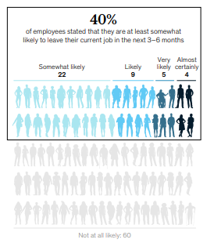
The early days of the pandemic reminded us that people are not machines
– Alison Omens
The Great Resignation
25+ people have resigned in the US since April 2021
Highest among mid-career employees
Highest among Tech and Health Care industries
Notes:
Page 11

Slide 5
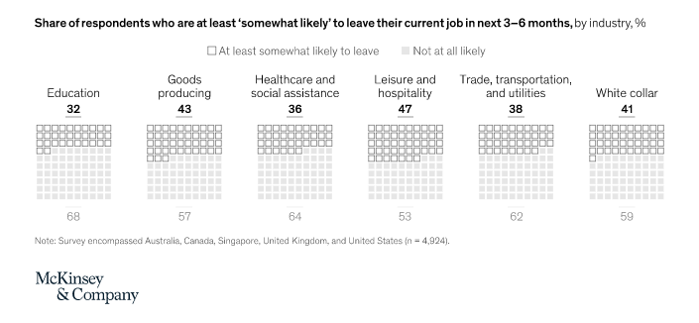
The Great Resignation
The Great Reshuffle
Notes:
Page 11

Slide 6
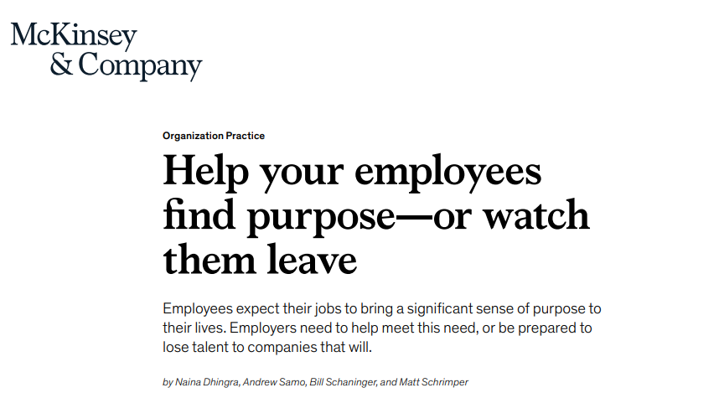

Slide 7
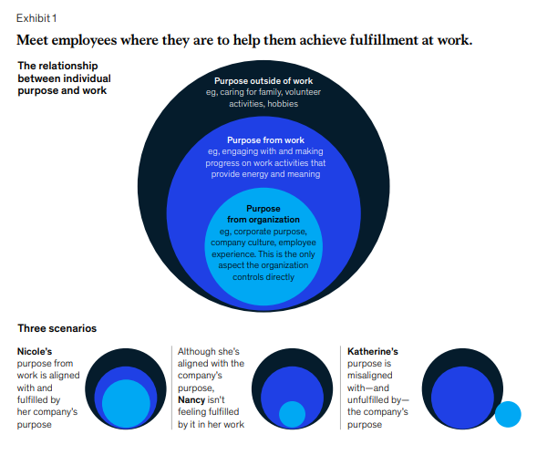
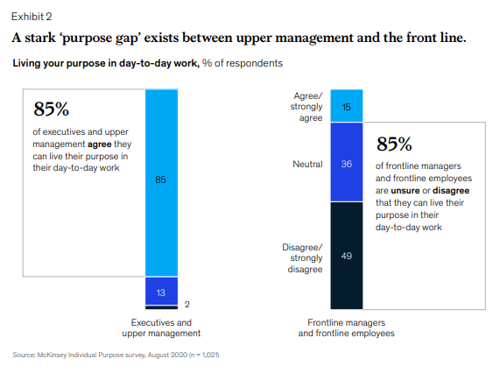

Slide 8
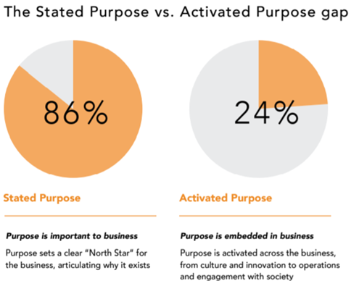

Slide 9
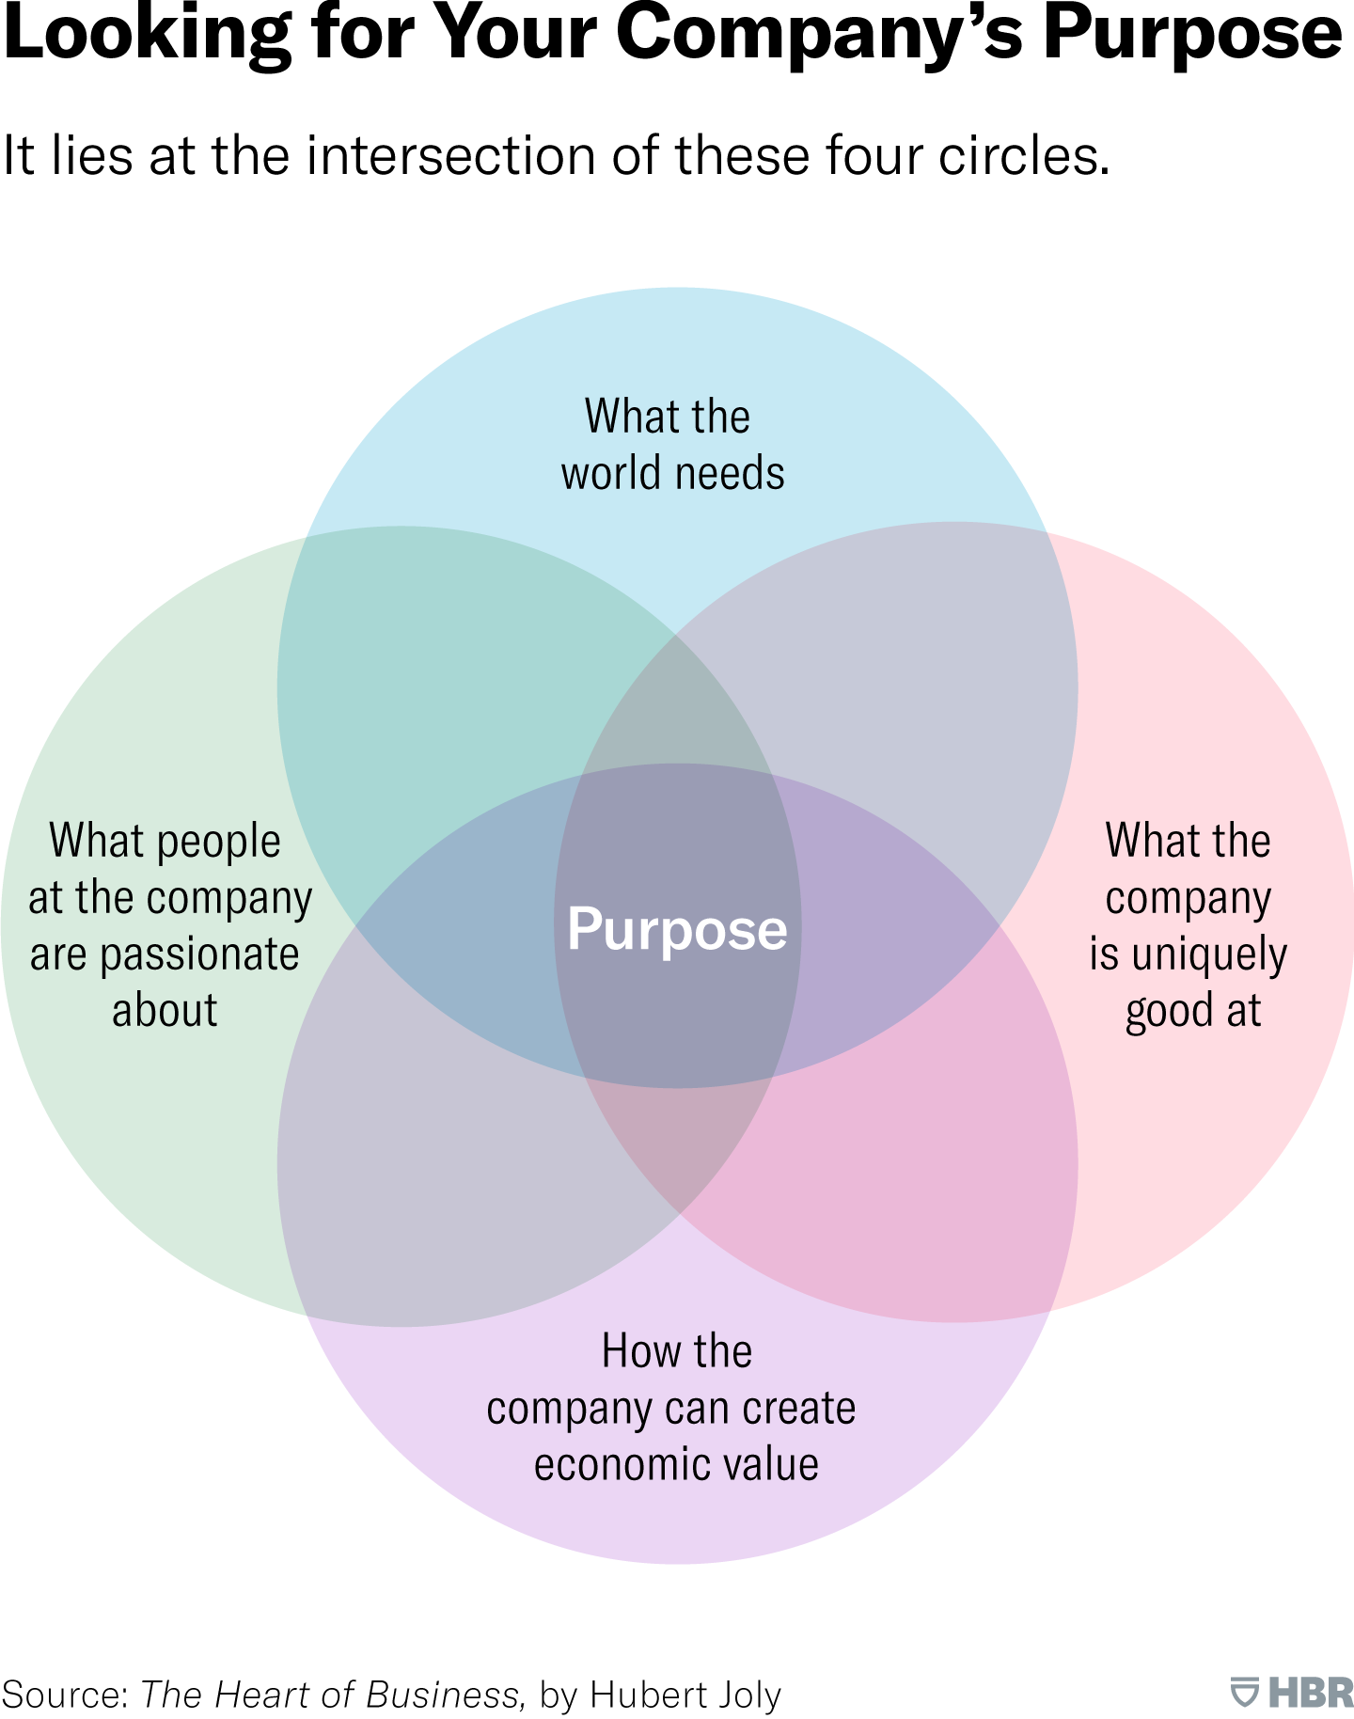
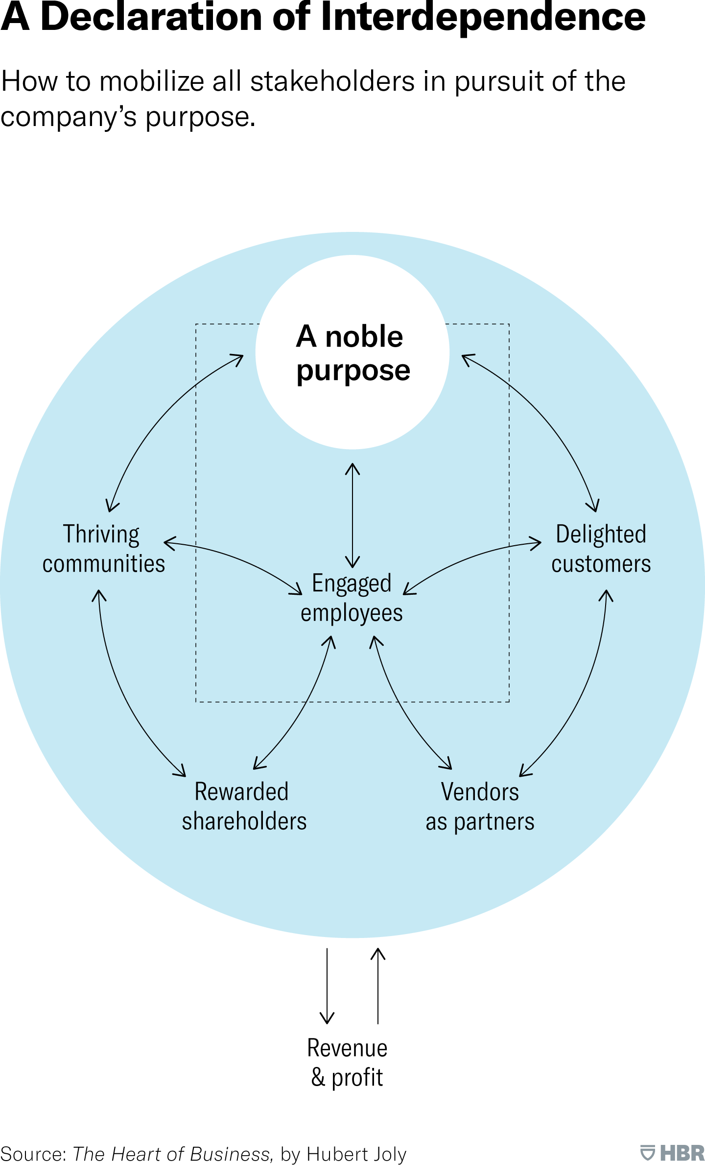
Creating a Meaningful Corporate Purpose
by Hubert Joly, Former Chairman and Former CEO of Best Buy, Oct 28, 2021, HBR

Slide 10
“People don’t buy what you do; people buy why you do it.”
Simon Sinek’s TED Talk about how great leaders inspire action
Adapted from Leading with Purpose in an Age Defined by It
Notes:
Page 5

Slide 11
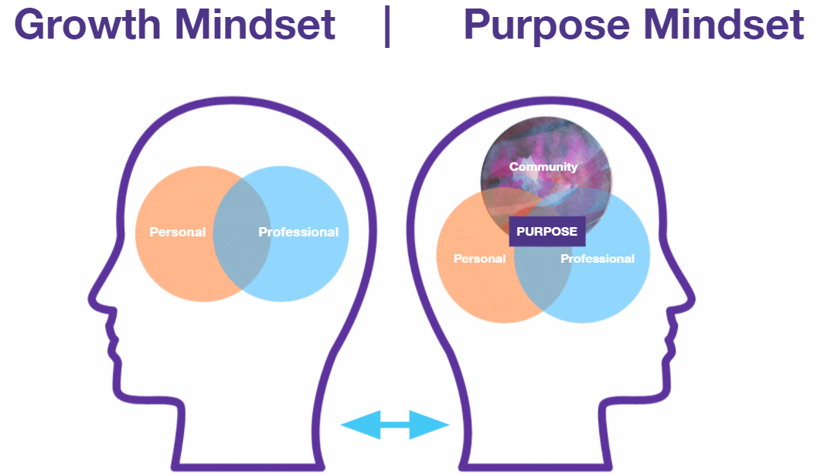
Notes:
Page 11

Slide 12
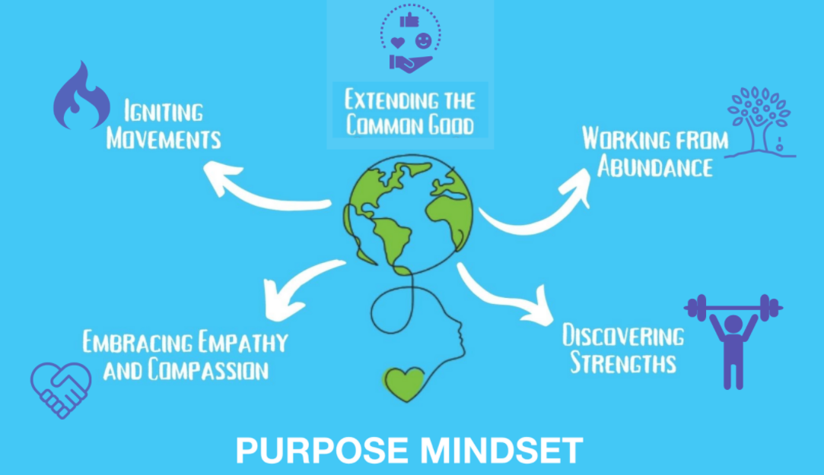
PURPOSE MINDSET: 5 PRINCIPLES
Notes:
Change to visual

Slide 13
PURPOSE MINDSET: 5 PRINCIPLES
Discovering Strengths—working from strengths and building on them to create greater possibilities.
Working from Abundance—accessing a variety of innovative resources, from people to equipment and space, at previously unthinkable scales.
Extending the Common Good—moving from doing things efficiently to having an impact on broad community progress.
Igniting Movements—focusing on building a movement, not an organization, that leads to societal change.
Embracing Empathy and Compassion —centering on the “we” rather than the “me.”
Notes:
Change to visual

Slide 14
PURPOSE isn’t a cause, revelation, or luxury – it is a CHOICE
PURPOSE builds bridging networks that span “diverse social cleavages” rather than bonding networks that reinforce exclusive identities and homogenous groups
PURPOSE ignites movements – via synchronizing rather than managing
PURPOSE is not about who you want to be, but who you want to SERVE

Slide 15
Task of leadership is to create an alignment of strengths in ways it makes our weaknesses irrelevant – Peter Drucker
Notes:
Change to visual

Slide 16
PURPOSE MINDSET: Excercise
10 minutes: Discovery Exercise
Strengths
Foundational Values
Purpose Statement
10 Minutes: Sharing
Notes:
Change to visual

Slide 17
Strengths | Values
Achiever | Altruism
Activator | Caring
Adaptable | Charitable
Analytical | Compassionate
Connector | Diplomacy
Consistent | Diversity
Communicator | Empathy
Deliberative | Ethics
Disciplined | Fair
Enthusiastic | Family
Focused | Giving
Futuristic | Gratitude
Learner | Harmony
Influencer | Humble
Open-Minded | Justice
Responsible | Kind
Strategic | Moral
Tolerant | Patient
Visionary | Spiritual
Wisdom | Trusting
Work Under Pressure | Wit
Name:
Email:
Please write a short purpose statement above
Example Format: My purpose is X (what you want to see - Impact) to Y (why you want to do this - Values) by Z (how you want to do this Strengths).
Akhtar Badshah
Through my teaching, writing and art, I help individuals and organizations bend the arc of humanity towards a better world.​"
Purpose Mindset Workshop - Sustainability Luxor - Google Forms
Select 3 each from Above, or Add Your Own

Slide 18
Purpose Mindset
Name:
Strengths
_________
__________
___________
Foundational Values
_________
__________
__________
Purpose Statement
You will receive email from
LuxorCIG@outlook.com

Slide 19
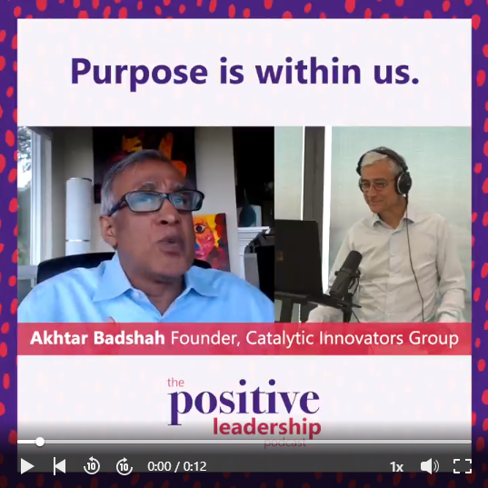
“For there is always light if only we are brave enough to see it, if only we are brave enough to be it.”
Amanda Gorman, Poet Laureate, US.
Purpose is the Light so Switch it on
The Great Resignation
https://lnkd.in/gRXt4h4S
Notes:
Page 11

Slide 20
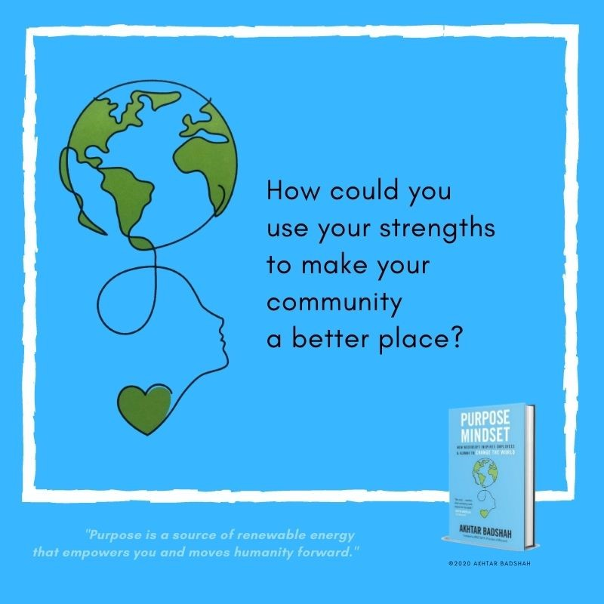

Slide 21
Purpose Mindset Reflection March 5
Purpose Mindset

Slide 22
Purpose Mindset
Name:
Strengths
_________
__________
___________
Foundational Values
_________
__________
__________
Purpose Statement

Slide 23
Purpose Mindset 1-on-1 Session
Purpose Mindset
In Pairs 45-minute session to be set up individually
Discuss:
1. Strengths & Foundational Values Discussion
2. Purpose Statement Reflection
3. Activating your Purpose for Luxor Sustainability Conference

Slide 24
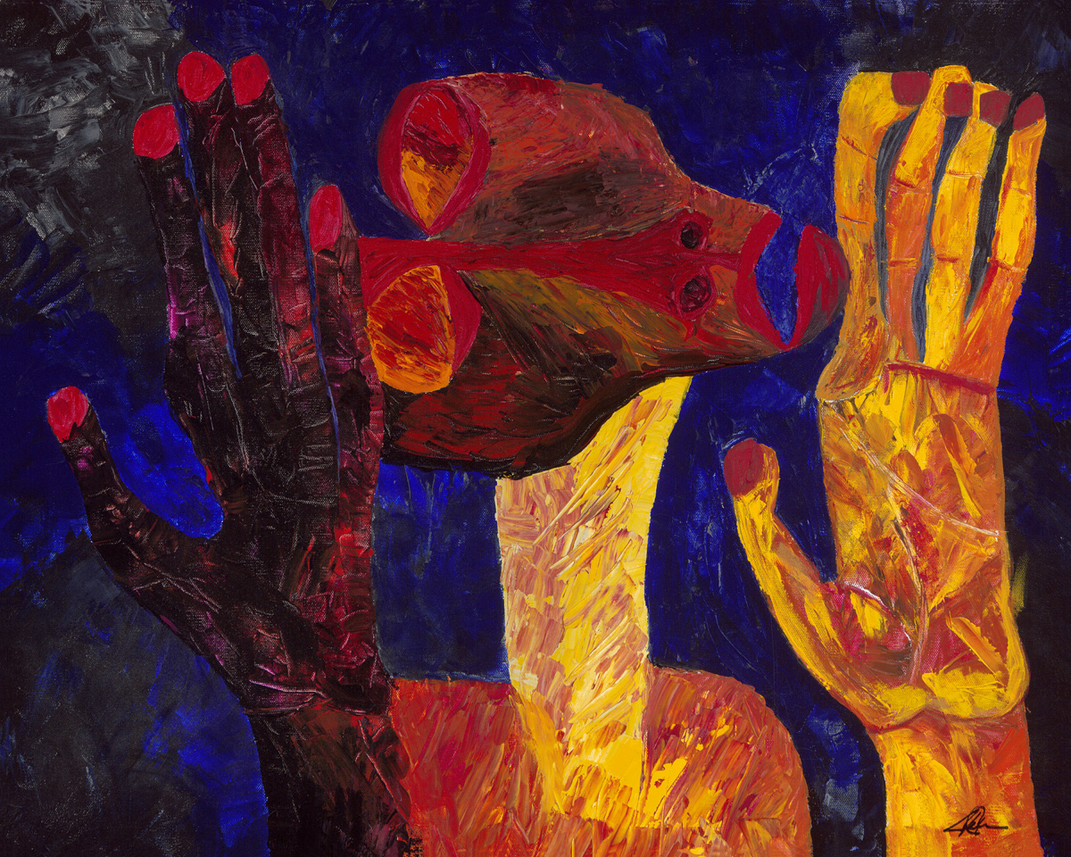
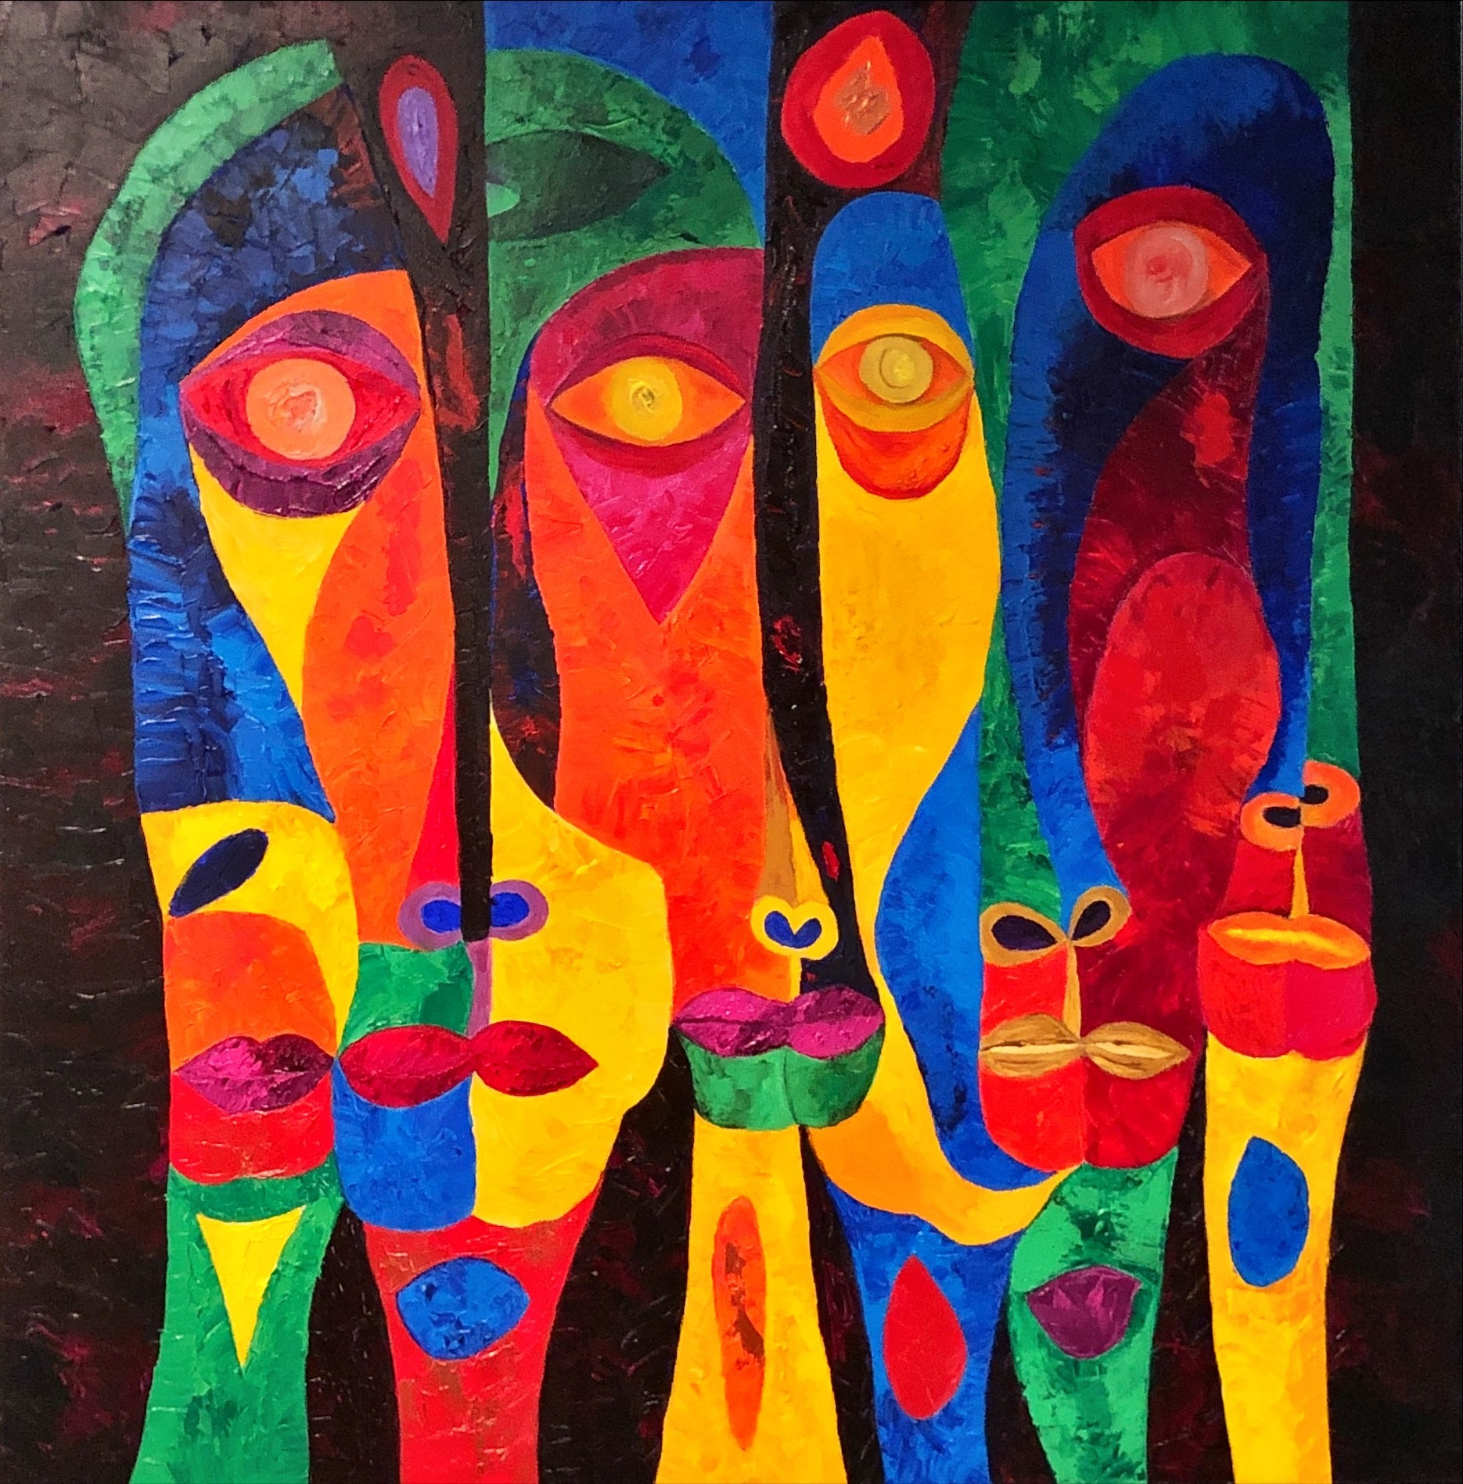
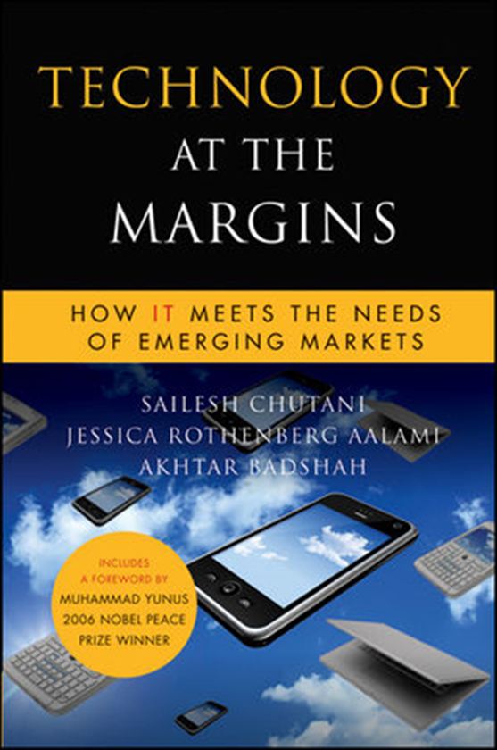
Akhtar Badshah
Innovation Catalyst
Artist
Architect
Author
Educator
Philanthropist
Social Entrepreneur
Thought Leader
"Through my teaching, writing and art,
I help individuals and organizations bend the arc of humanity towards a better world.​"

